Slide 1
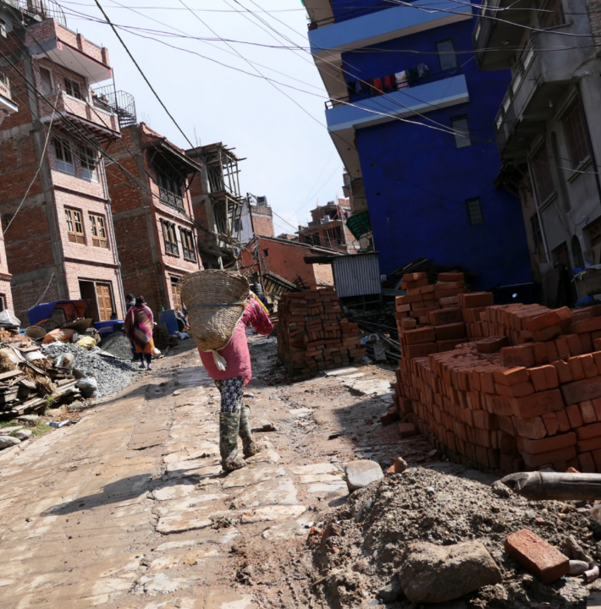
“Our mission is to reduce disaster risk for the poor in tomorrow’s cities”
Acting to Reduce Risk in Tomorrow's Cities
Small Hall 09.00 - 18.00
1

Slide 2
Acting to Reduce Risk in Tomorrow's Cities
Small Hall 09.00 - 18.00
09.00 - 10.00 Open exhibition with tour
10.00 - 11.00 Panel I: Data challenges for equitable urban futures
11.00 - 12.00 Immersive experience: Futuring methodologies
12.00 - 13.00 LUNCH and open exhibition
13.00 - 14.00 Open exhibition with tour
14.00 - 15.00 Panel II: Inclusive enabling environments for just disaster governance
15.00 - 16.00 Immersive experience: Futuring methodologies
16.00 - 18.00 Open exhibition and networking

Slide 3
- Changing cities – rapid urban growth (strategic, opportunistic and spontaneous) - Changing risks – climate change and multi-hazard interactions - Changing capacities – new knowledge available, new viewpoints being formed
Urban planners
face three key challenges for resilient and inclusive development:
Challenges that interact!!!

Slide 4
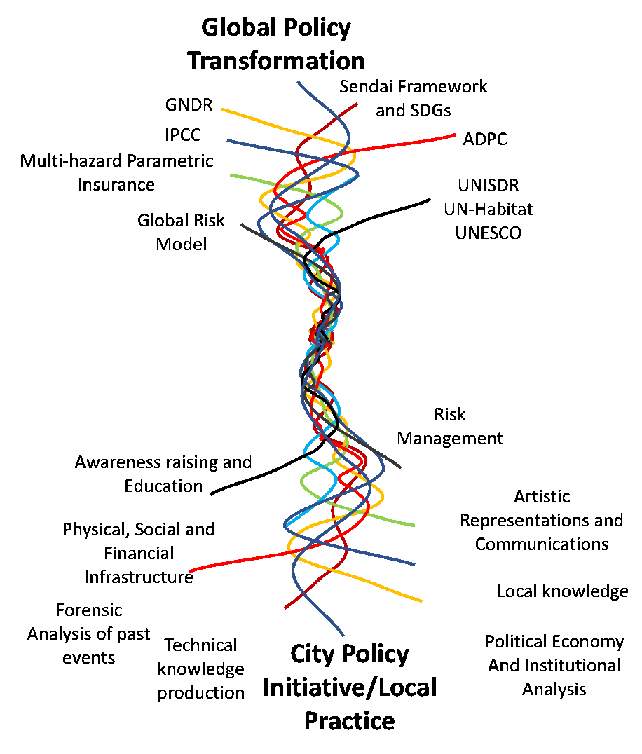
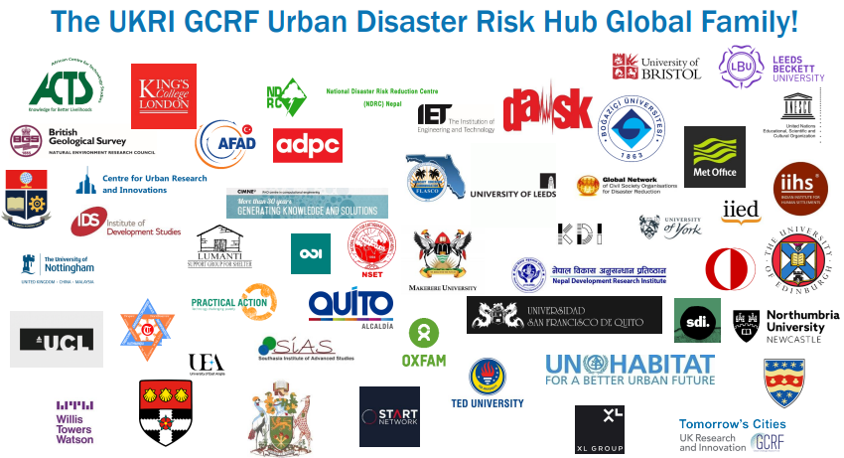
The Tomorrow’s Cities Decision Support Environment
The Urban Disaster Risk Hub
2019-2024; £5m
70+ partners
4 Learning Cities: Istanbul, Kathmandu, Quito, Nairobi
5 Deployment Cities: Nablus, Rapti, Dar es Salaam, Chattogram, Cox’s Bazar

Slide 5
Seven Stages of the facilitated TCDSE
Aspiring
Testing
Acting
Targeting
Proposing
Learning
Reviewing
and
Sharing
Notes:
Invite people to learn more by looking at the posters

Slide 6
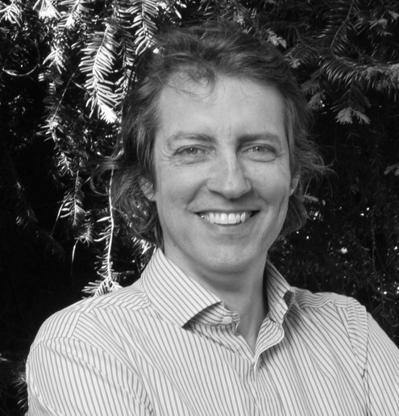
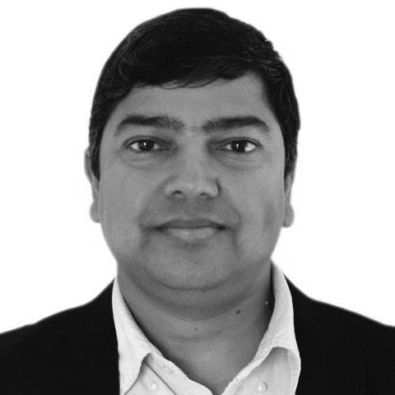
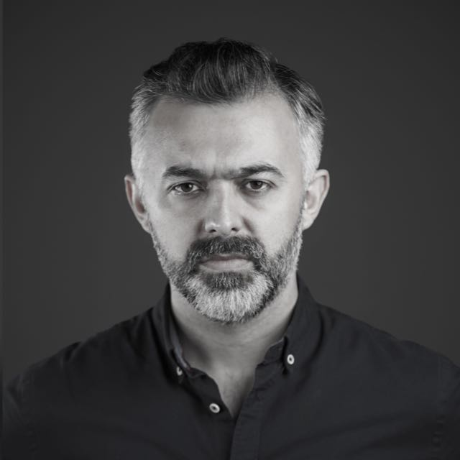
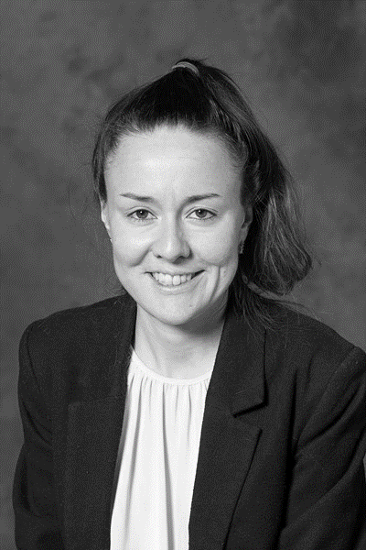
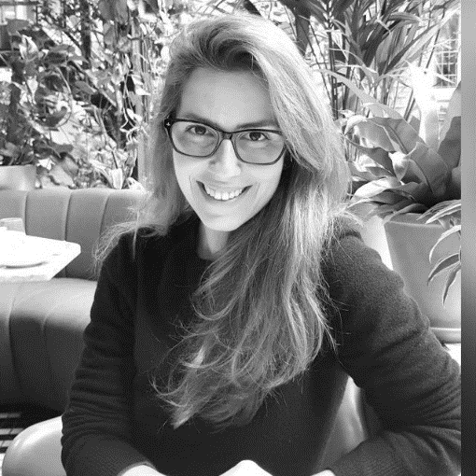
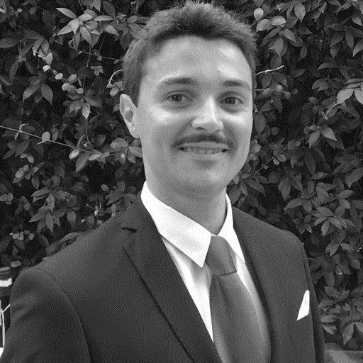
Tomorrow’s Cities Research and Development Team Here
Prof. Mark Pelling
Science Director
Dr. Ramesh Guragain
Capacity Strengthening Lead
Dr. Emin Menteşe
Urban Scenarios
Dr. Gemma Cremen
Hazard & Impact Modelling
Dr. Thaisa Comelli
Future Visioning
Dr. Roberto Gentile
Risk Agreement

Slide 7
Acting to Reduce Risk in Tomorrow's Cities
Small Hall 09.00 - 18.00
09.00 - 10.00 Open exhibition with tour
10.00 - 11.00 Panel I: Data challenges for equitable urban futures
11.00 - 12.00 Immersive experience: Futuring methodologies
12.00 - 13.00 LUNCH and open exhibition
13.00 - 14.00 Open exhibition with tour
14.00 - 15.00 Panel II: Inclusive enabling environments for just disaster governance
15.00 - 16.00 Immersive experience: Futuring methodologies
16.00 - 18.00 Open exhibition and networking

Slide 8
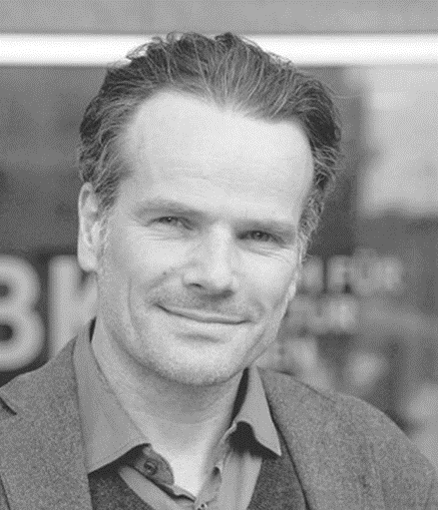
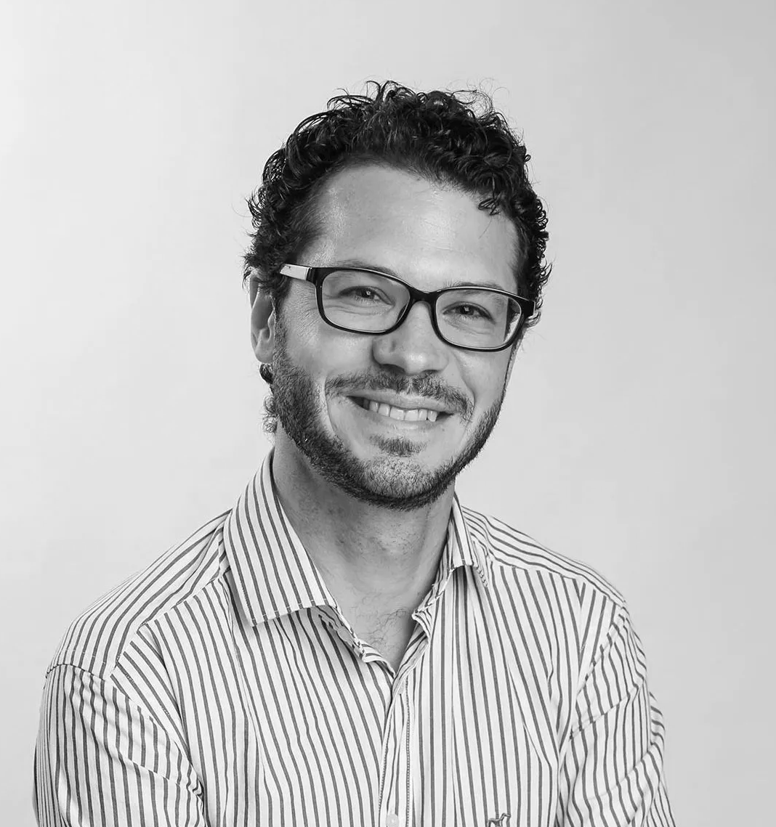
Panel I: Challenges and opportunities for disaster risk modelling in data scarce, unequal and yet-to-be-built urban contexts
Moderator: Dr. Gemma Cremen
Dr. Joerg Noenning
Dr. David Lallemant
Dr. Emin Menteşe
Dr. Roberto Gentile

Slide 9
Panel I: Challenges and opportunities for disaster risk modelling in data scarce, unequal and yet-to-be-built urban contexts
Q1 - Data Challenges for Urban Futures: What are the challenges associated with risk-informed planning in data scarce urban environments?
Q2 - Systems thinking: How can risk models be improved to better capture consequences on interacting physical and social systems?
Q3 - People centred approaches: How do we account for equity in (future) disaster risk assessments?

Slide 10
Panel I: Challenges and opportunities for disaster risk modelling in data scarce, unequal and yet-to-be-built urban contexts
Q1 - Data Challenges for Urban Futures: What are the challenges associated with risk-informed planning in data scarce urban environments?
Q2 - Systems thinking: How can risk models be improved to better capture consequences on interacting physical and social systems?
Q3 - People centred approaches: How do we account for equity in (future) disaster risk assessments?

Slide 11
Panel I: Challenges and opportunities for disaster risk modelling in data scarce, unequal and yet-to-be-built urban contexts
Q1 - Data Challenges for Urban Futures: What are the challenges associated with risk-informed planning in data scarce urban environments?
Q2 - Systems thinking: How can risk models be improved to better capture consequences on interacting physical and social systems?
Q3 - People centred approaches: How do we account for equity in (future) disaster risk assessments?

Slide 12
Panel I: Challenges and opportunities for disaster risk modelling in data scarce, unequal and yet-to-be-built urban contexts
Q1 - Data Challenges for Urban Futures: What are the challenges associated with risk-informed planning in data scarce urban environments?
Q2 - Systems thinking: How can risk models be improved to better capture consequences on interacting physical and social systems?
Q3 - People centred approaches: How do we account for equity in (future) disaster risk assessments?

Slide 13
Acting to Reduce Risk in Tomorrow's Cities
Small Hall 09.00 - 18.00
09.00 - 10.00 Open exhibition with tour
10.00 - 11.00 Panel I: Data challenges for equitable urban futures
11.00 - 12.00 Immersive experience: Futuring methodologies
12.00 - 13.00 LUNCH and open exhibition
13.00 - 14.00 Open exhibition with tour
14.00 - 15.00 Panel II: Inclusive enabling environments for just disaster governance
15.00 - 16.00 Immersive experience: Futuring methodologies
16.00 - 18.00 Open exhibition and networking

Slide 14
Immersive Experience Guides
Dr. Thaisa Comelli
Future Visioning
Dr. Emin Menteşe
Urban Scenarios
Dr. Gemma Cremen
Hazard & Impact Modelling
Dr. Ramesh Guragain
Capacity Strengthening Lead
Dr. Roberto Gentile
Risk Agreement

Slide 16
“Our mission is to reduce disaster risk for the poor in tomorrow’s cities”
Acting to Reduce Risk in Tomorrow's Cities
Small Hall 09.00 - 18.00
16

Slide 17
Acting to Reduce Risk in Tomorrow's Cities
Small Hall 09.00 - 18.00
09.00 - 10.00 Open exhibition with tour
10.00 - 11.00 Panel I: Data challenges for equitable urban futures
11.00 - 12.00 Immersive experience: Futuring methodologies
12.00 - 13.00 LUNCH and open exhibition
13.00 - 14.00 Open exhibition with tour
14.00 - 15.00 Panel II: Inclusive enabling environments for just disaster governance
15.00 - 16.00 Immersive experience: Futuring methodologies
16.00 - 18.00 Open exhibition and networking

Slide 18
- Changing cities – rapid urban growth (strategic, opportunistic and spontaneous) - Changing risks – climate change and multi-hazard interactions - Changing capacities – new knowledge available, new viewpoints being formed
Urban planners
face three key challenges for resilient and inclusive development:
Challenges that interact!!!

Slide 19
The Tomorrow’s Cities Decision Support Environment
The Urban Disaster Risk Hub
2019-2024; £5m
70+ partners
4 Learning Cities: Istanbul, Kathmandu, Quito, Nairobi
5 Deployment Cities: Nablus, Rapti, Dar es Salaam, Chattogram, Cox’s Bazar

Slide 20
Seven Stages of the facilitated TCDSE
Aspiring
Testing
Acting
Targeting
Proposing
Learning
Reviewing
and
Sharing
Notes:
Invite people to learn more by looking at the posters

Slide 21
Acting to Reduce Risk in Tomorrow's Cities
Small Hall 09.00 - 18.00
09.00 - 10.00 Open exhibition with tour
10.00 - 11.00 Panel I: Data challenges for equitable urban futures
11.00 - 12.00 Immersive experience: Futuring methodologies
12.00 - 13.00 LUNCH and open exhibition
13.00 - 14.00 Open exhibition with tour
14.00 - 15.00 Panel II: Inclusive enabling environments for just disaster governance
15.00 - 16.00 Immersive experience: Futuring methodologies
16.00 - 18.00 Open exhibition and networking

Slide 22
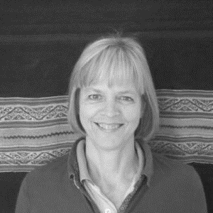
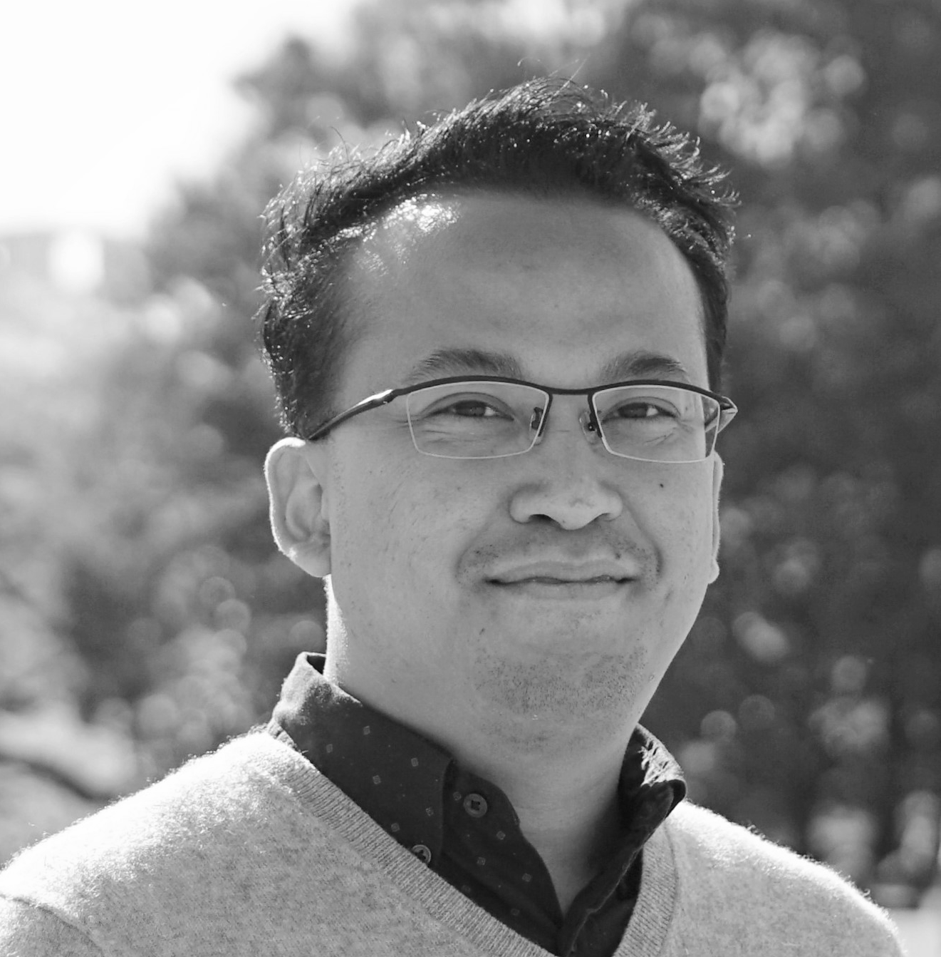
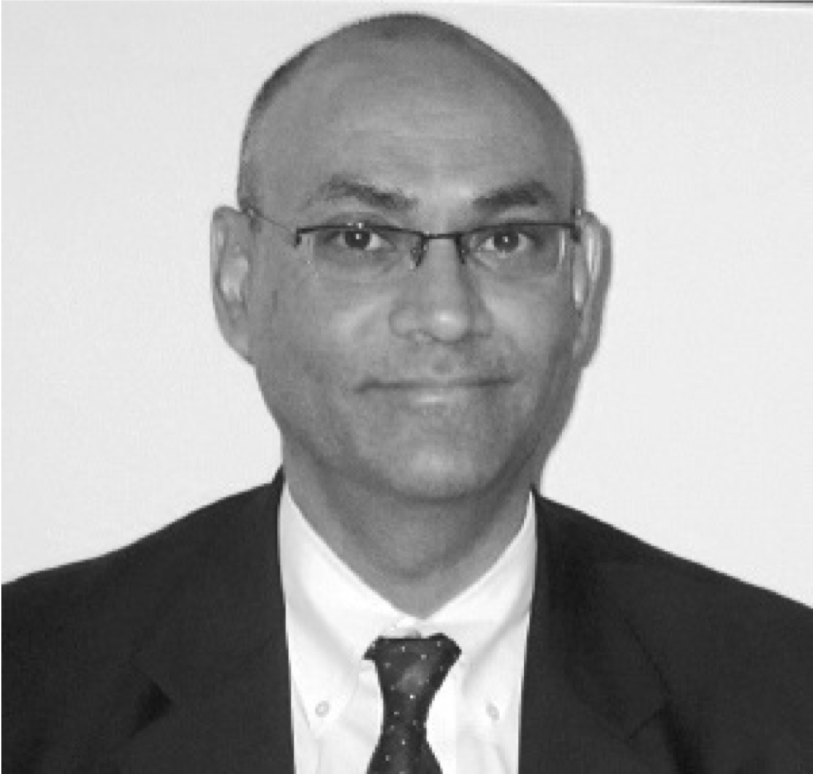
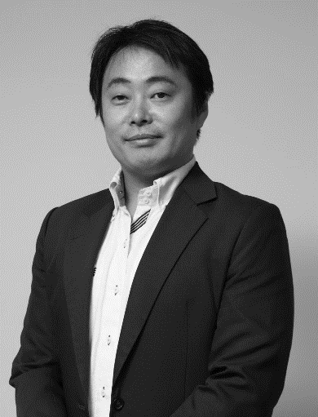
Panel II: Building an inclusive enabling environment for more just disaster governance in the global south
Moderator: Ms. Sara Hoeflich
Dr. Mizan Bisri
Dr. Ramesh Guragain
Mr. Sanjaya Bhatia
Dr. Takeshi Komino
Dr. Thaisa Comelli

Slide 23
Panel II: Building an inclusive enabling environment for more just disaster governance in the global south
Q1 - Surfacing diverse values: What are the challenges of approaching long-term risk-informed future planning in an inclusive way?
Q2 - Social role of science: how can interactions between science and planning enable stakeholders to learn together and make informed decisions on the basis of dynamic disaster risk?
Q3 - Readiness for future thinking: How fit is our current enabling environment (and institutions) to work on the future (risk-informed urban planning)?

Slide 24
Panel II: Building an inclusive enabling environment for more just disaster governance in the global south
Q1 - Surfacing diverse values: What are the challenges of approaching long-term risk-informed future planning in an inclusive way?
Q2 - Social role of science: how can interactions between science and planning enable stakeholders to learn together and make informed decisions on the basis of dynamic disaster risk?
Q3 - Readiness for future thinking: How fit is our current enabling environment (and institutions) to work on the future (risk-informed urban planning)?

Slide 25
Panel II: Building an inclusive enabling environment for more just disaster governance in the global south
Q1 - Surfacing diverse values: What are the challenges of approaching long-term risk-informed future planning in an inclusive way?
Q2 - Social role of science: how can interactions between science and planning enable stakeholders to learn together and make informed decisions on the basis of dynamic disaster risk?
Q3 - Readiness for future thinking: How fit is our current enabling environment (and institutions) to work on the future (risk-informed urban planning)?

Slide 26
Panel II: Building an inclusive enabling environment for more just disaster governance in the global south
Q1 - Surfacing diverse values: What are the challenges of approaching long-term risk-informed future planning in an inclusive way?
Q2 - Social role of science: how can interactions between science and planning enable stakeholders to learn together and make informed decisions on the basis of dynamic disaster risk?
Q3 - Readiness for future thinking: How fit is our current enabling environment (and institutions) to work on the future (risk-informed urban planning)?

Slide 27
Acting to Reduce Risk in Tomorrow's Cities
Small Hall 09.00 - 18.00
09.00 - 10.00 Open exhibition with tour
10.00 - 11.00 Panel I: Data challenges for equitable urban futures
11.00 - 12.00 Immersive experience: Futuring methodologies
12.00 - 13.00 LUNCH and open exhibition
13.00 - 14.00 Open exhibition with tour
14.00 - 15.00 Panel II: Inclusive enabling environments for just disaster governance
15.00 - 16.00 Immersive experience: Futuring methodologies
16.00 - 18.00 Open exhibition and networking

Slide 28
Immersive Experience Guides
Dr. Thaisa Comelli
Future Visioning
Dr. Emin Menteşe
Urban Scenarios
Dr. Gemma Cremen
Hazard & Impact Modelling
Dr. Ramesh Guragain
Capacity Strengthening Lead
Dr. Roberto Gentile
Risk Agreement

Slide 29
“Our mission is to reduce disaster risk for the poor in tomorrow’s cities”
Acting to Reduce Risk in Tomorrow's Cities
Small Hall 09.00 - 18.00
29

